Slide 1
background
Taught by Yossef Ayman Zedan

Slide 2
Basics of background colors
Since we talked about bg-primary, secondary, success, danger, warning, info, light and dark, we will talk about the rest of the bg
1- .bg-white that has: {
--bs-bg-opacity: 1;
background-color: rgba(var(--bs-white-rgb),var(--bs-bg-opacity))!important; }
We will discuss the –bs-bg-opacity in this presentation
2- .bg-transparent {
--bs-bg-opacity: 1;
background-color: transparent!important;
}

Slide 3
Basics of background colors
To add gradient, add .bg-gradient after the class of the bg-color
<div class="p-3 mb-2 bg-primary text-white bg-gradient">.bg-primary</div>

Slide 4
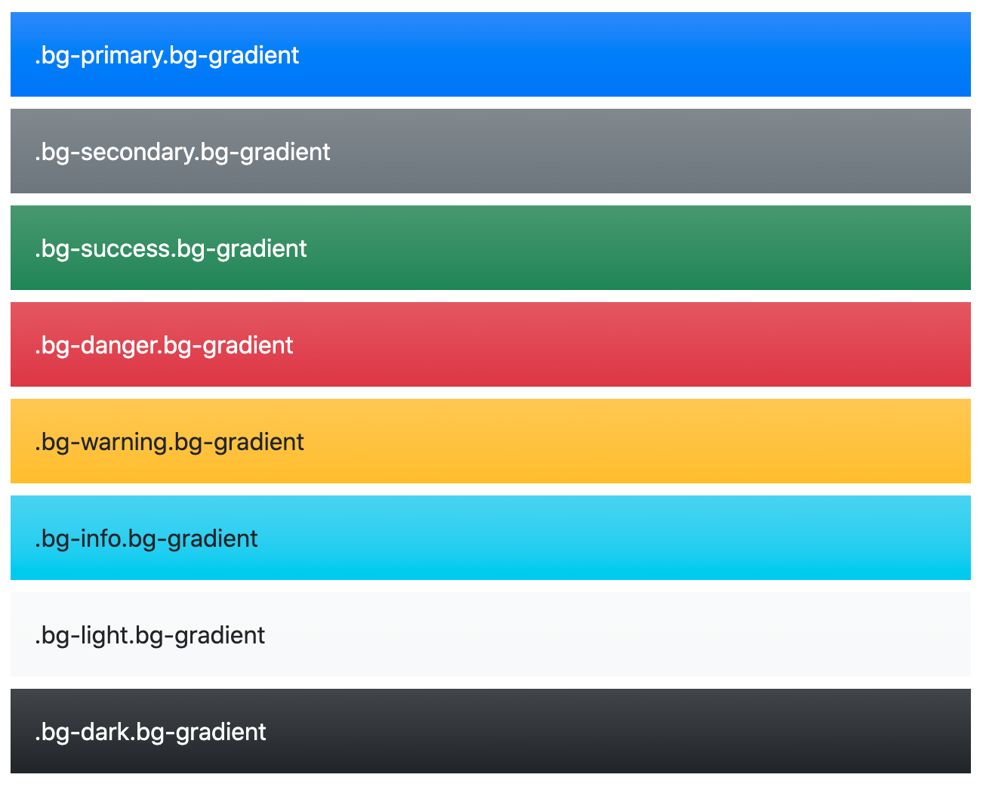

Slide 5
Opacity
background-color utilities are generated with Sass using CSS variables. This allows for real-time color changes without compilation and dynamic alpha transparency changes.
Consider the default .bg-success utility.
.bg-success {
--bs-bg-opacity: 1;
background-color: rgba(var(--bs-success-rgb), var(--bs-bg-opacity)) !important;
}
<div class="bg-success p-2 text-white">This is default success background</div>
<div class="bg-success p-2" style="--bs-bg-opacity: .5;">This is 50% opacity success background</div>

Slide 6

Opacity

Slide 7

Opacity classes
bg-opacity-75: 0.75;
bg-opacity-50: 0.5;
bg-opacity-25: 0.25;
bg-opacity-10: 0.1;

